Slide 1

CHALLENGES AND OPPORTUNITIES OF THE DIGITAL TRANSFORMATION
Raül Blanco, Secretary General of Industry and SMEs
Regional Workshop
“Social consequences of the digital transformation in companies: Giving industrial trade unions the tools to act”
8th October 2019

Slide 2
The importance of digitalization
Spain progresses in the digitalization process
The digital transformation affects all the economic sectors
A proactive digital agenda in industry and services
Industry 4.0
Commerce digitalization
Intelligent touristic destination
Training in digital talent
Let’s work together to digitise our country

Slide 3
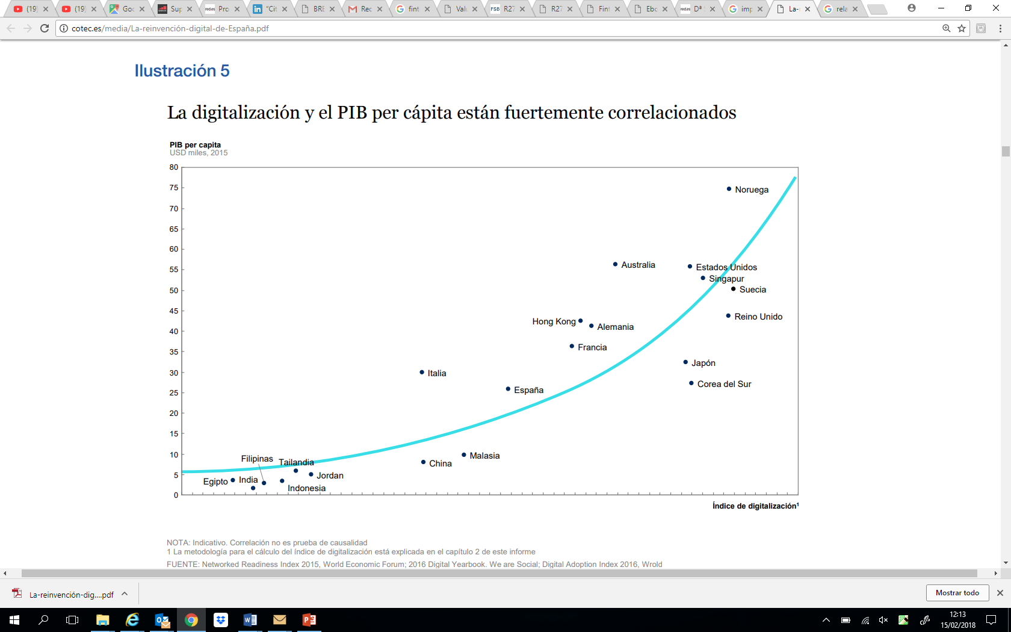
A clear correlation between the degree of digitisation of a country and its wealth
GDP per capita
Thousands USD, 2015
The technological and digital transformation is, and will continue to be in the future, one of the fundamental levers to improve economic growth, competitiveness and social welfare.
In addition, its transversal nature makes it a key factor in increasing productivity.
Digitisation could mean an increase in GDP between 1.8% and 2.3% until 2025
Spain
Digitization index
Source: COTEC Report [The digital reinvention: an opportunity for Spain, July 2017]

Slide 4
The importance of digitalization
Spain progresses in the digitalization process
The digital transformation affects all the economic sectors
A proactive digital agenda in industry and services
Industry 4.0
Commerce digitalization
Intelligent touristic destination
Training in digital talent
Let’s work together to digitise our country

Slide 5
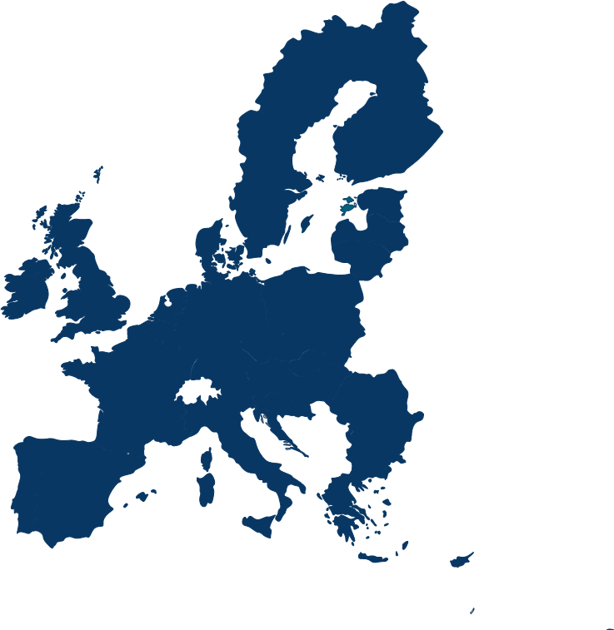
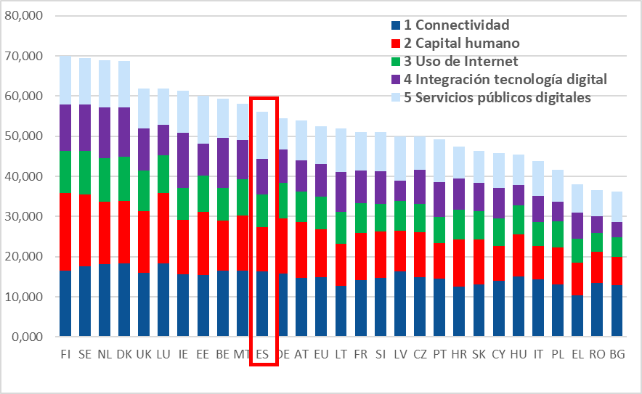
Spain keeps its pace of progress in the digitisation of the economy and the society…
Spain
EU
rank
score
score
DESI 2019
11
56,1
52,5
Spain maintains the 11th position in the 2019 DESI European rank
DESI 2018
11
53,2
49,8
DESI 2017
13
49,1
46,9
Transición ecológica
Dimension
Rank
Public digital services
1
Connectivity
9
Cuarta revolución industrial
Digital technology integration
10
Internet use
11
Human capital
17
Source: Digital Society and Economy Index (DESI) 2019
The improvement of human capital is a priority goal for the Government. The Agenda for Change identifies the promotion of scientific and technological progress and the bet for training and human capital as two of its priorities in its reforms route.

Slide 6
...but it is only capturing a portion of the digital potential
The digital economy represents 5.6% of Spain’s GDP and only 13.5% of the digital potential is being captured.
The main obstacles in the digital transition are the low digitisation of some economic sectors and SMEs, a start-up ecosystem still in development, the relative scarcity of venture capital investment and the lack of digital human capital
Transición ecológica
Cuarta revolución industrial
Source: COTEC Report [The digital reinvention: an opportunity for Spain, July 2017]

Slide 7
The importance of digitalization
Spain progresses in the digitalization process
The digital transformation affects all the economic sectors
A proactive digital agenda in industry and services
Industry 4.0
Commerce digitalization
Intelligent touristic destination
Training in digital talent
Let’s work together to digitise our country

Slide 8

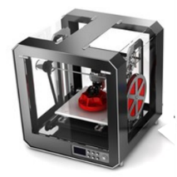





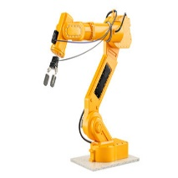
Data are a strategic asset in Economy 4.0, where technologies enables the capture of its value
Enabling levers
Technologies
Data
0I0I
0I0I
Cloud computing
Additive manufacturing
Economy 4.0
Connectivity
Blockchain
Cybersecurity
Processing capacity
Artificial intelligence
5G
Storage capacity
Internet of Things
Autonomous robots

Slide 9




Industry 4.0 impacts on products, processes and business models and turns around a user with new priorities and tools
Intelligent products
&
Platforms
product
Intelligent fabrics
From ownership to use
Information
The incorporations of sensors allows for fitting clothing with new functionalities
From product to platform
&
All-channels
Sustainability
Car Sharing
process
Customization
&
Quickness
Efficiency
The Internet of Things allows to move from a model purchase to another one based on use
Flexibility
3D printing
Business model
3D printing speeds up design and prototyping and reduces the time-to-market

Slide 10
Industry digitisation will lead to important yields
Productivity and efficiency improvement
Value creation in industrial sectors (10³ M$)
Productivity and efficiency improvement
Revenue increase
Revenue increase
Product innovation and development
166-477
+
8-25
3-10%
4-9%
198-499
Manufacturing and delivery
0
Potential impact on global markets
0.3-0.9 billon $
0.3-0.7 billon $
Sales
74-298
4-6
Overall profitability
Maintenance and service
40-111
44-63
Headquarters operations
280-887
315-715
9-22%
61-122
Total
0.8-2.0 billon $
Source: McKinsey & Company. The trillion-dollar opportunity for the industrial sector

Slide 11
The importance of digitalization
Spain progresses in the digitalization process
The digital transformation affects all the economic sectors
A proactive digital agenda in industry and services
Industry 4.0
Commerce digitalization
Intelligent touristic destination
Training in digital talent
Let’s work together to digitise our country

Slide 12



The Ministry owns several instruments to stimulate the industry’s digitisation
Boost to investment in R&D&i projects linked to Industry 4.0 technologies
30 M€ 2018 + 50 M€ 2019
Specialised advising to support the companies’ digital transformation
3 M€
Call closing:
16 September
Technology-based companies program
Projects leading to a technological step ahead in obtaining new products, processes or services

Slide 13
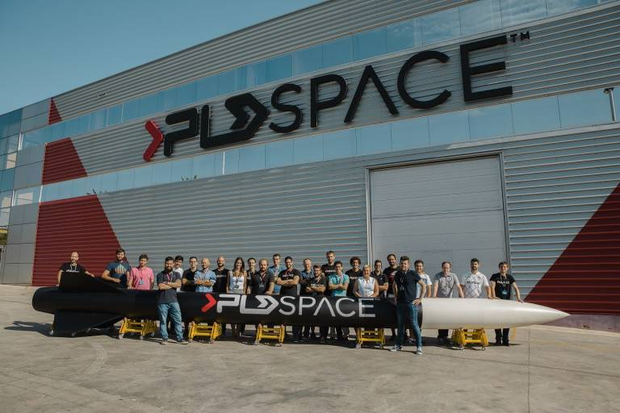
https://www.youtube.com/watch?v=LjSDjx_ZaCk

Slide 14

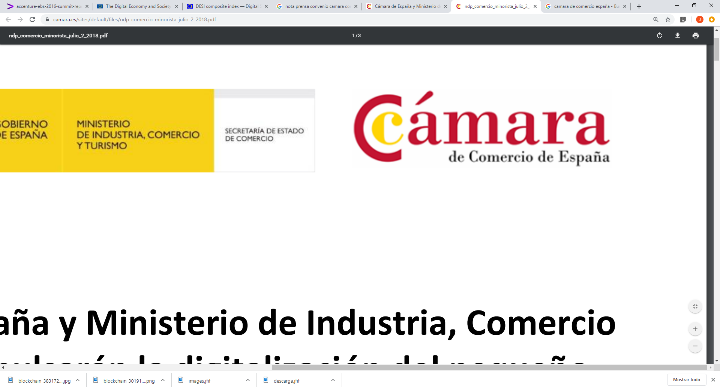
The traditional commerce’s digitisation is also within our priorities
Public-private debate forum
Commerce
4.0 Observatory
Strengthening of proximity commerce
Trend analysis
Identification of best practices
Supporting the small commerce’s digital transformation to favour its adaptation to new commercial schemes and consuming habits
Agreement
Commercial innovation program
Analysis to provide strategic, innovative and digital recommendations for the management of the establishment
01
Commercial capacity-enhancement program
Collective capacity-enhancement actions in areas like the digital customer, e-commerce, digital marketing, tourism of purchases or sales techniques
02

Slide 15





Technology eases the sustainability of touristic destinations and the quality of visitor’s experience
Objectives
Destination’s sustainable development
The Intelligent Touristic Destination Network eases the incorporation of innovations in destinations and promotes the collaboration of all the key actors. It comprises 60 municipalities and institutional members
Spain is positioned as the world leader in the development of intelligent touristic destinations.
Accessibility for all
Visitor’s integration into the environment
Improvement of residents’ quality of life
Axes
TECHNOLOGY
sustainability
innovation
accessibility
Governance
The UNWTO has acknowledged that “the use of technologic solutions under the intelligent touristic destination model contributes to improve the process of making informed decisions, to the prioritization of measures and to the anticipation of future scenarios, which is essential for the responsible management of Tourism and its impact”.

Slide 16

Talent development, attraction and retention is critical
Programs
Master in Big Data
Founded in 1955, it is Spain’s first business school
In 2009 it was the first business school to implement the mobile learning technology in all its programs with the use of mobile devices and an institutional repository of open multimedia contents (Savia).
In 2013 it was the first business school to offer postgraduate training in Big Data.
Master Digital Business
Postgraduate program in Blockchain
Executive Master in Digital Business
Postgraduate Program in Machine Learning and Artificial Intelligence
Executive Program in Digital Transformation for Public Administration
Executive Program in Big Data & Business Analytics
……..

Slide 17


12 challenges of industry 4.0
VITUAL CO-WORKING SPACE FOR STARTUP ACCELERATION
Launching of industrial innovation challenges in the scope of Industry 4.0
  Identification of tractor-effect industrial firms that propose technology innovation challenges to be solved by technology-based start-ups.
Call and start-ups identification
  Open innovation, corporate acceleration process
Benefits for start-ups
    Prototype development/training and mentoring/networking/clients
    “Acquisition” of a big industrial client
    Country-wide visibility

Slide 18
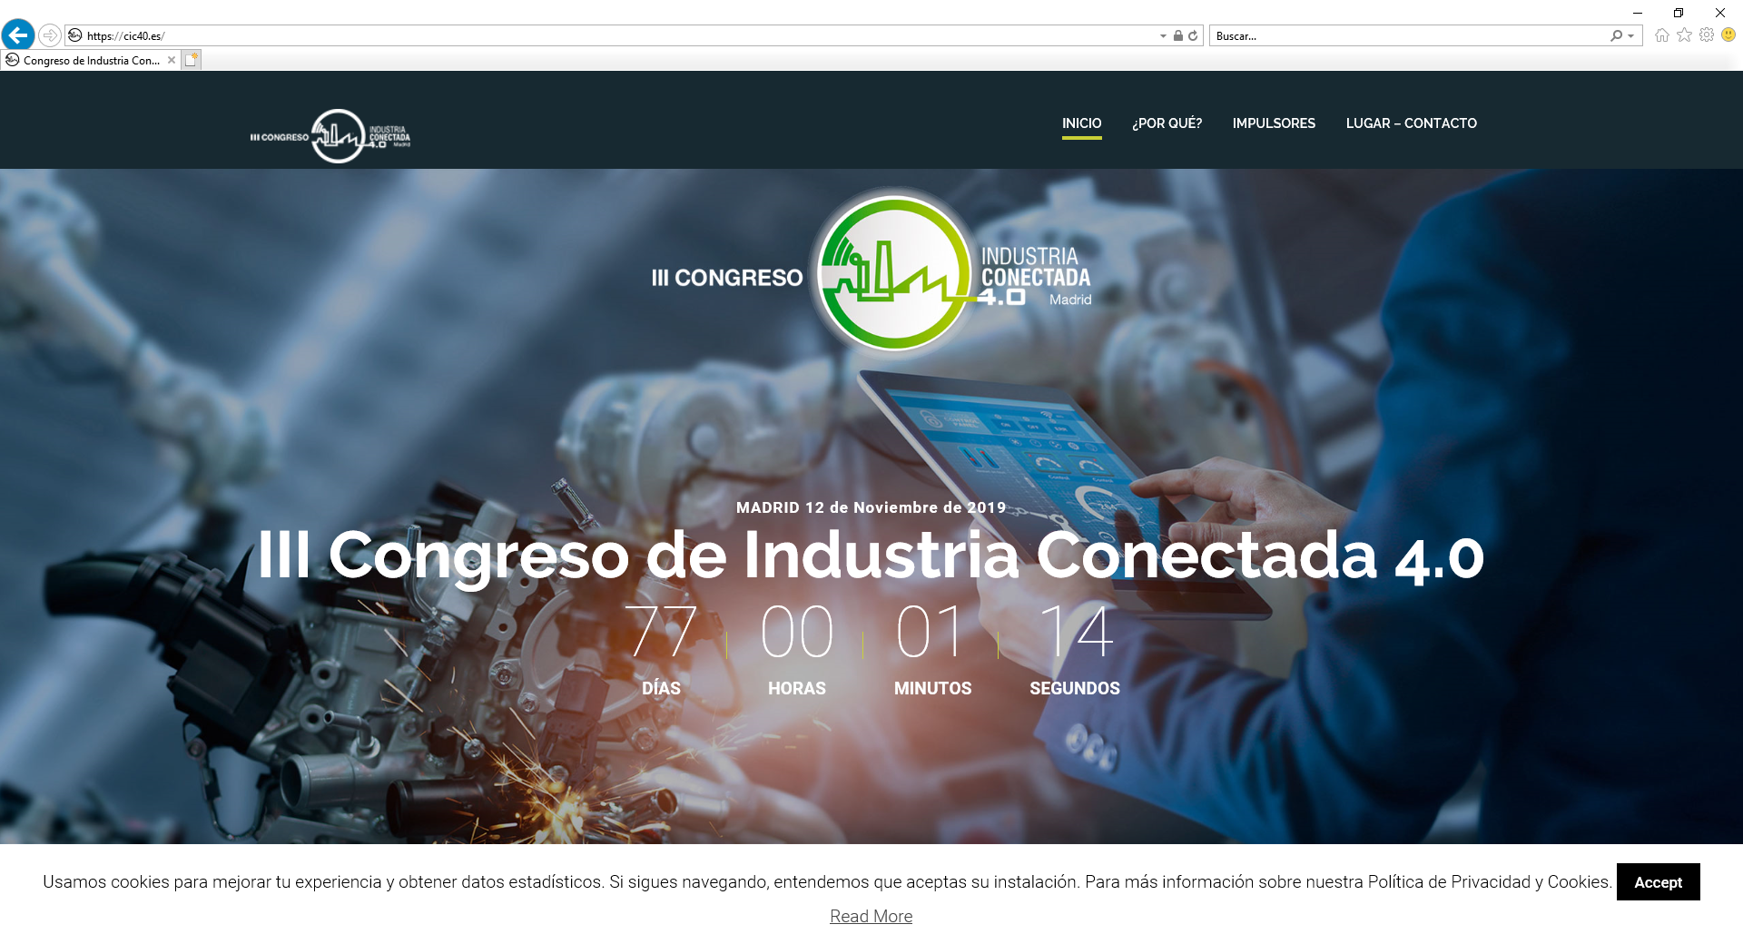
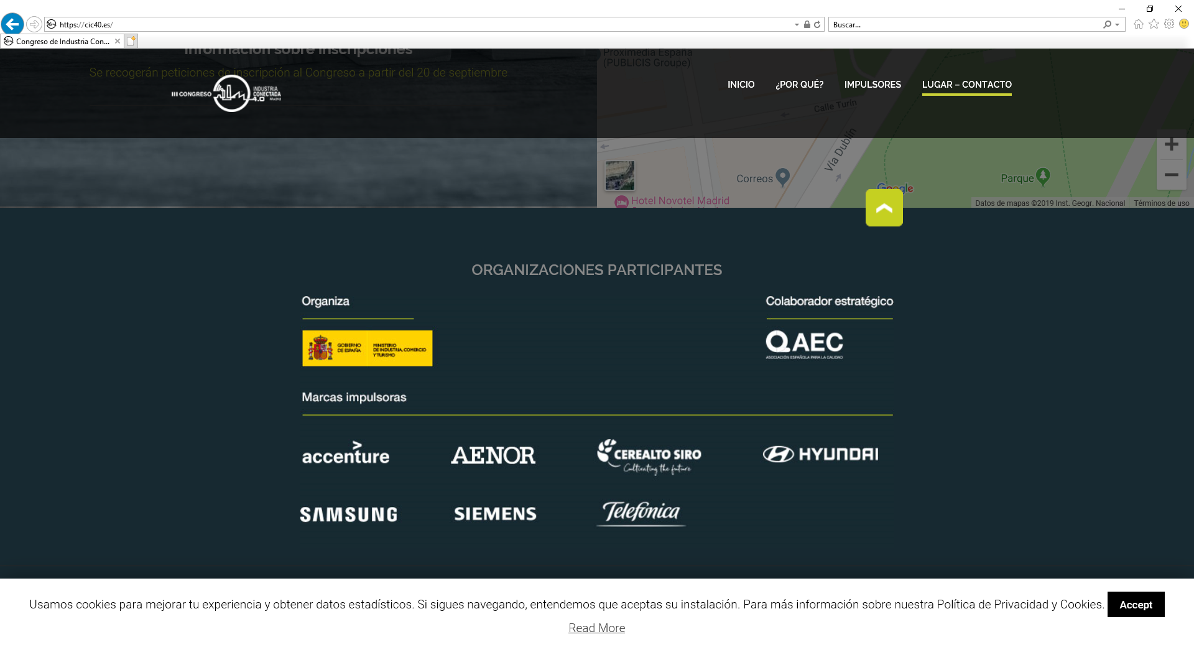

Slide 19
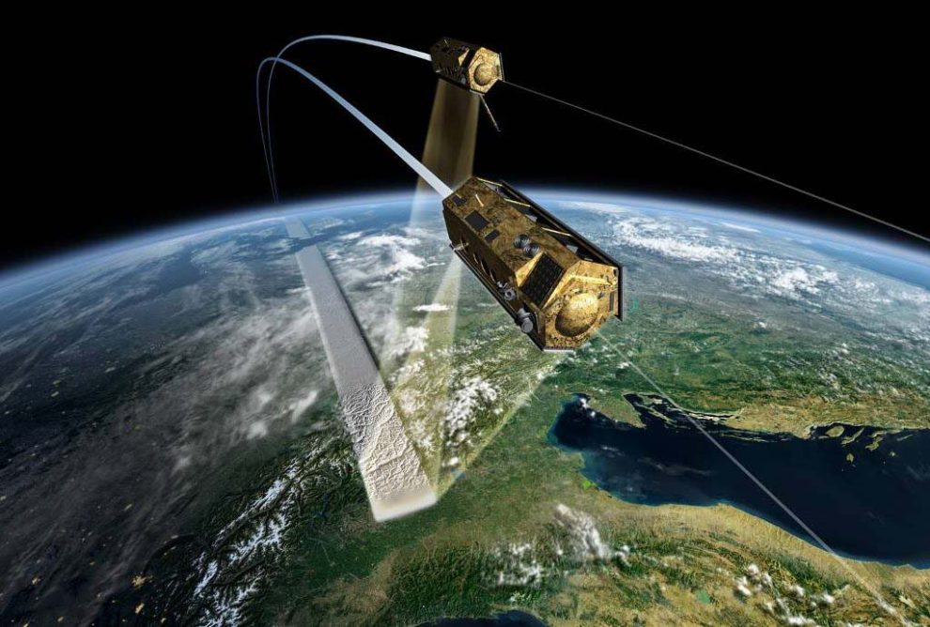
Support to space industry (1)
  HISDESAT: Earth observation
    PAZ: Synthetic-aperture radar (SAR) for security and defence applications. HISDESAT is responsible for its manufacturing and management.
    The Ministry and its predecessors have partially funded the development through a 0% interest, risk loan to HISDESAT amounting to 110 M€.
    The satellite is in FOC since September 2018.
    The start of loan repayment by HISDESAT will commence end of 2019

Slide 20
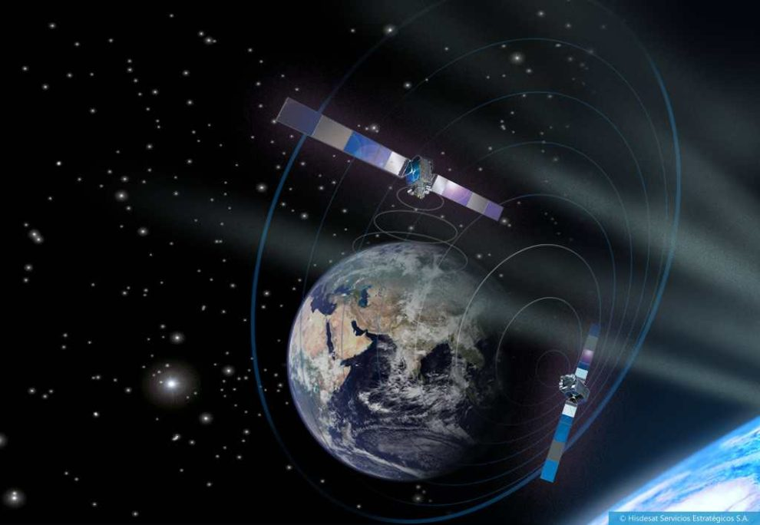
Support to space industry (2)
  HISDESAT: Satellite communications
    SPAINSAT NG: Two-satellite communication system for Defence purposes and governmental users.
    Budget: 750 M€
    Funding: MINCOTUR, 0% loan, 13 years repayment (first 4, interest-only)
    Certain elements are funded by ESA’s InCube program

Slide 21
Support to projects related to Defence programs
  Loans to technologic development projects
  Provision in 2018’s State Budget: 468 M€

Slide 22
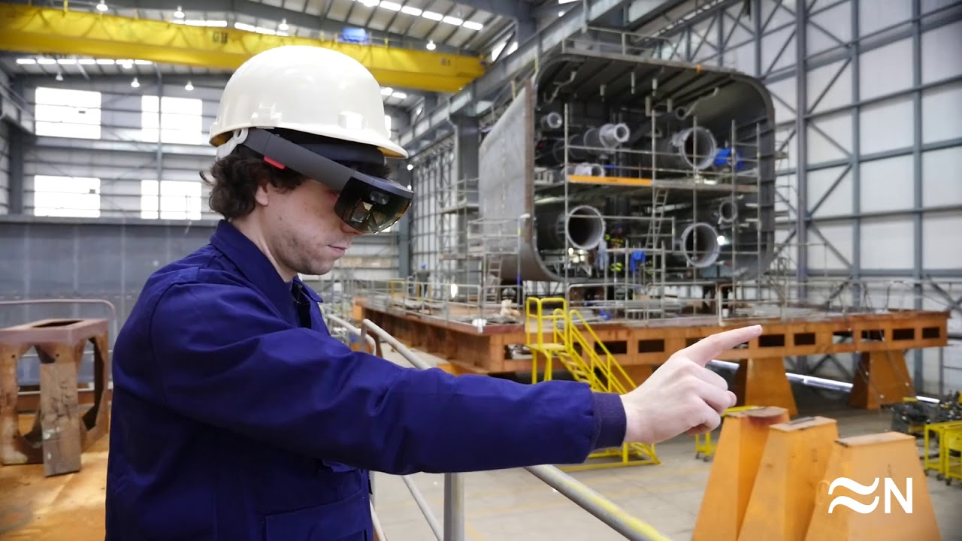


Slide 23
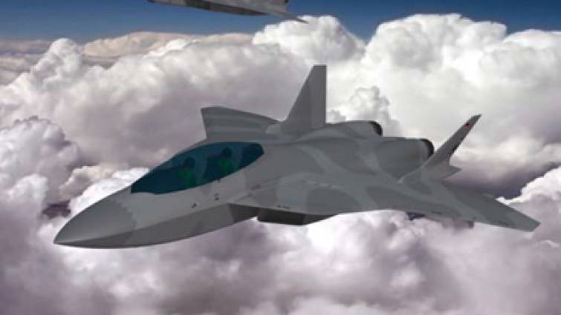

Slide 24
The importance of digitalization
Spain progresses in the digitalization process
The digital transformation affects all the economic sectors
A proactive digital agenda in industry and services
Industry 4.0
Commerce digitalization
Intelligent touristic destination
Training in digital talent
Let’s work together to digitise our country

Slide 25

Public-private collaboration is key to face the challenge successfully
Spain has the opportunity to lead digital transition and become a European reference in this new economy, but every one’s effort is needed in order to achieve it.
Big assets
Leading digital infrastructures
+
Entrepreneurship
PUBLIC- PRIVATE COLLABORATION
Reference companies in many economic sectors
Highly-recognised Universities
Link between Europe, LATAM and Mediterranean countries
Capacity to attract and develop technologic talent
Digitisation National Strategy

Slide 26
FINAL CONSIDERATIONS

Slide 27


Slide 28
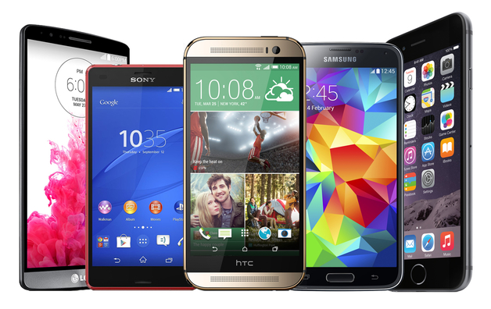
Customer rules the world.
Customer should be served immediately.

Slide 29

Customer rules the world.
Customer should be served immediately.

Slide 30














Number of years it took each product to gain 50 million users
Airlines
Cars
Telephone
Electricity
Credit card
TV
ATM
68 years
62 years
50 years
46 years
28 years
22 years
18 years
Computers
Mobiles
Internet
iPad
YouTube
Facebook
Twitter
14 years
12 years
7 years
4 years
4 years
3 years
2 years

Slide 31
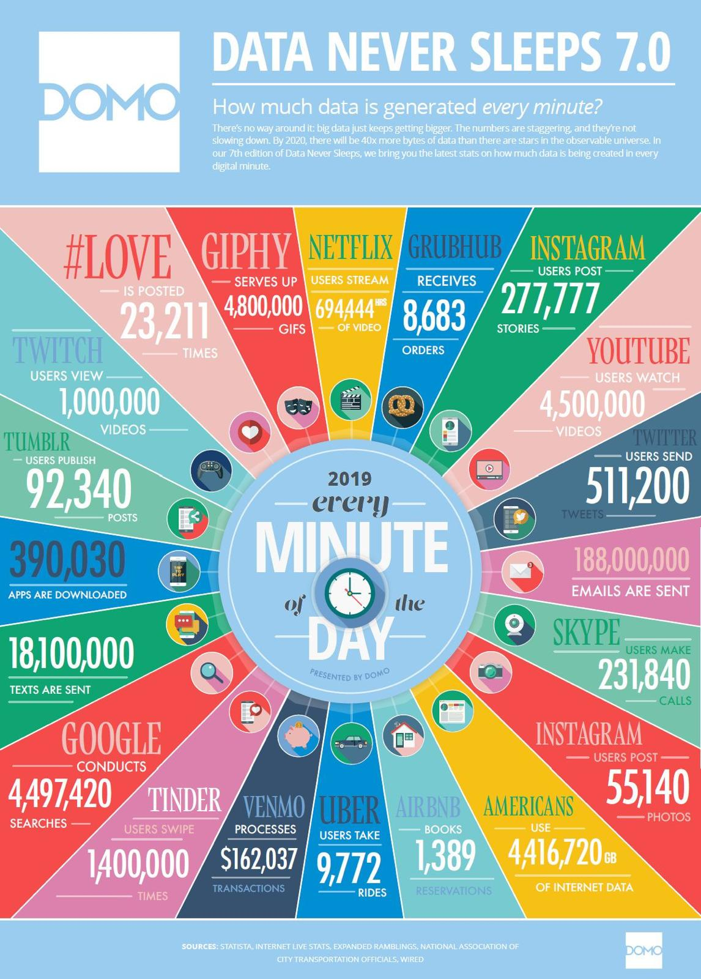

Slide 32
Industry’s digital transformation is:
20% Technology
80% Business model
People and their qualification will be, in turn, keys of success in the business model

Slide 33
Unlike former periods, changes go from SOCIETY to INDUSTRY
(And much more quickly than ever before)

Slide 34


SECRETARÍA GENERAL DE INDUSTRIA Y DE LA PEQUEÑA Y MEDIANA EMPRESA
LÍNEAS DE POLÍTICA INDUSTRIAL

Slide 36


Slide 37



FINAL CONSIDERATIONS

Slide 38

FINAL CONSIDERATIONS

Slide 39
THANK YOU VERY MUCH FOR YOUR ATTENTION

